Slide 1

E-Commence Website
CS594 Senior Capstone Project
Prof. Ahmed Banafa
Liang Chen 19798 Weijia Xu 19797

Slide 2
Agenda
Project Goals
Adminstrative Goals
Project Timeline
Organized UML Diagram
UML Diagram
Frontend Figures
Backend Figures
Database Schema
Demo
Conclusion

Slide 3
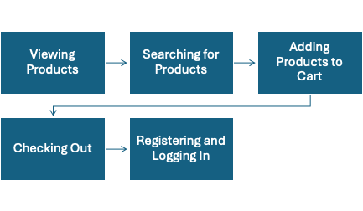
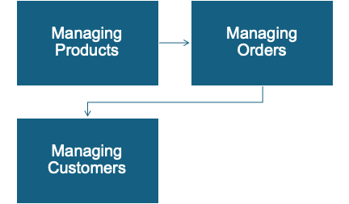
Project Goals
Administrative Goal

Slide 4
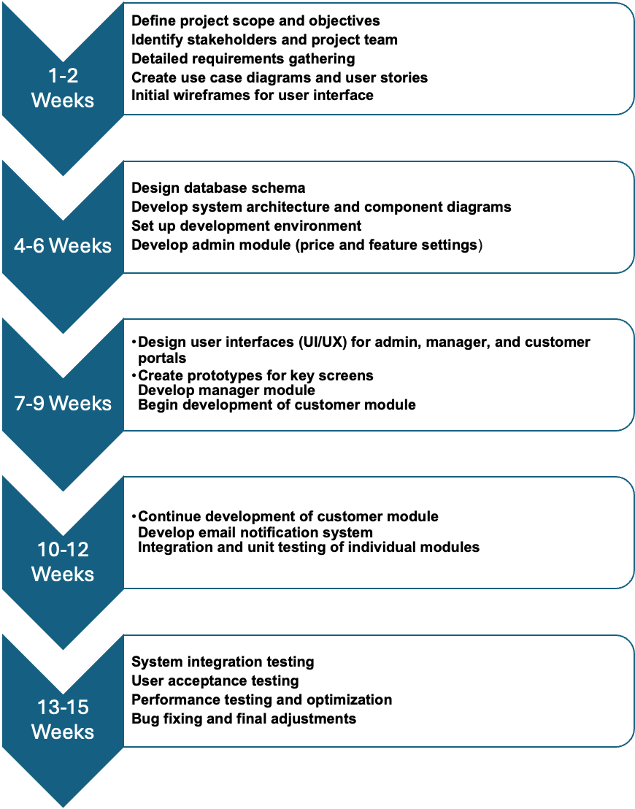
Project Timeline
Project scope and objectives
Project structure Design
Modules Design
Modules Design and Improvement
System Testing

Slide 5
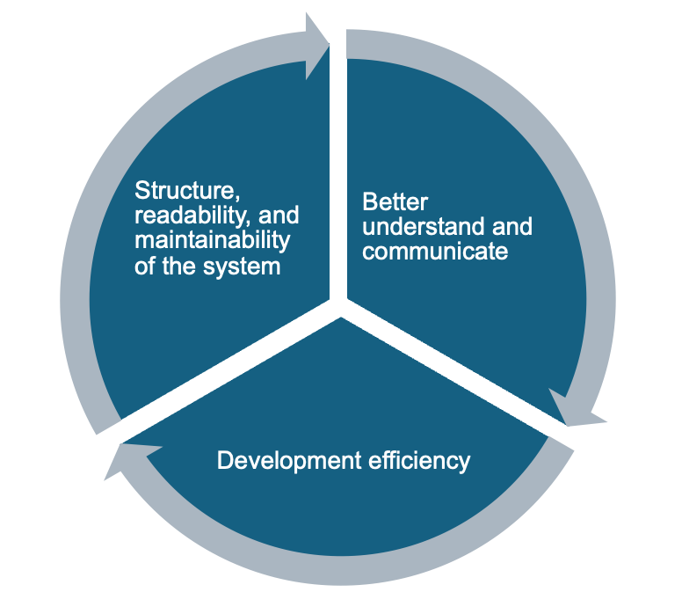
Organized UML Diagram

Slide 6
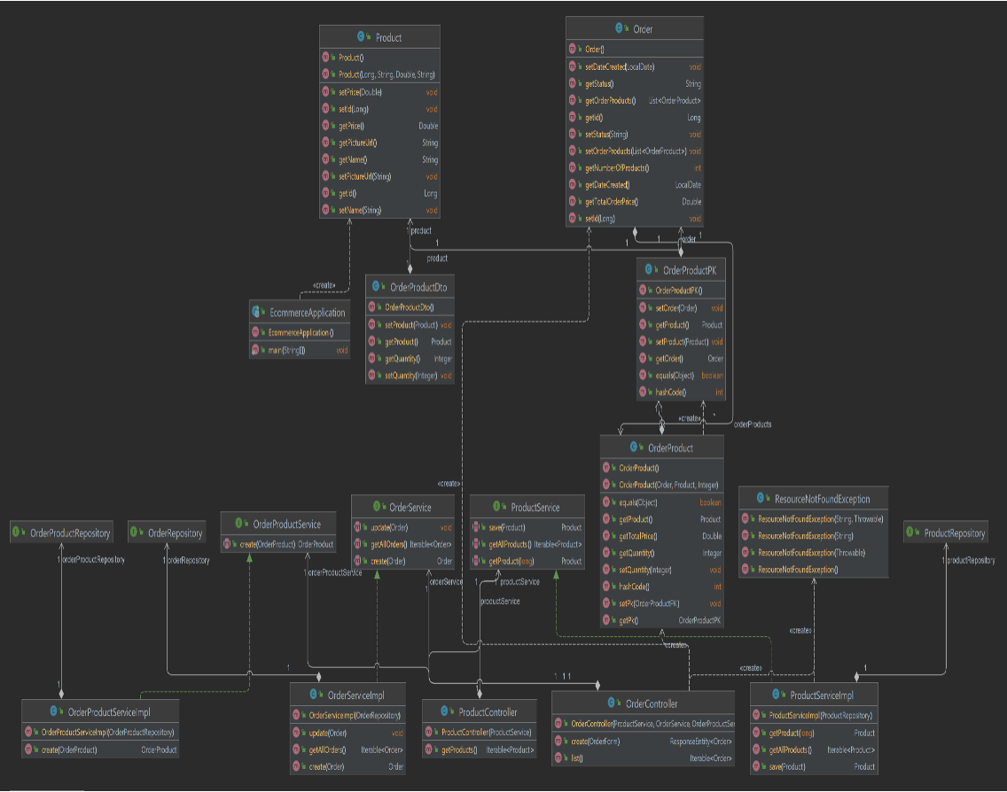
UML Diagram

Slide 7
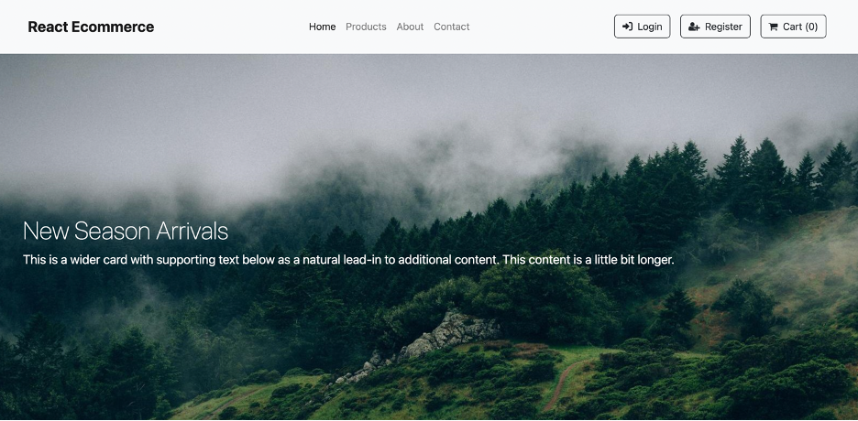
Frontend Layout & Figures
New Season Products
Home Page
Products Page
About Page
Contact
Login Figures
Register Figures
Cart Adding and Checkout Figures

Slide 8
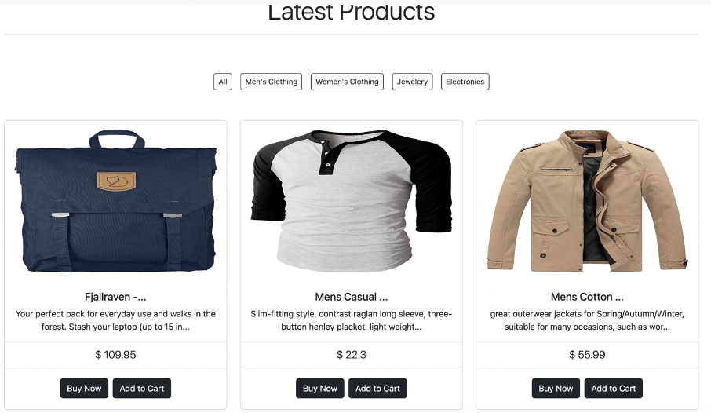
Frontend Layout & Figures
Latest Products
Product Catelog
Price Overview
Buy or Add to Cart

Slide 9
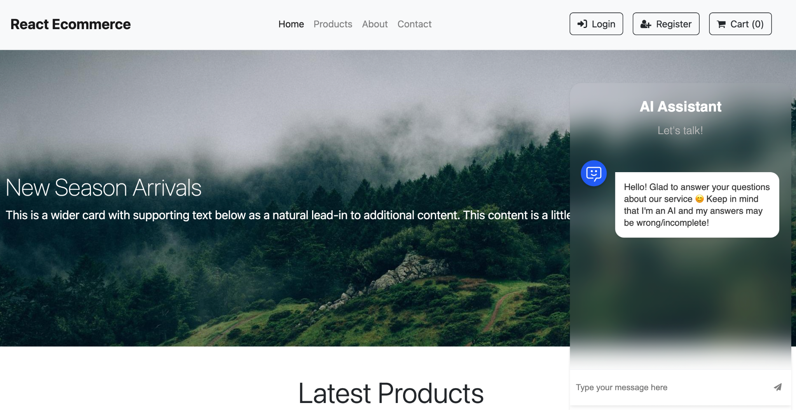
AI Chatbot Frame

Slide 10
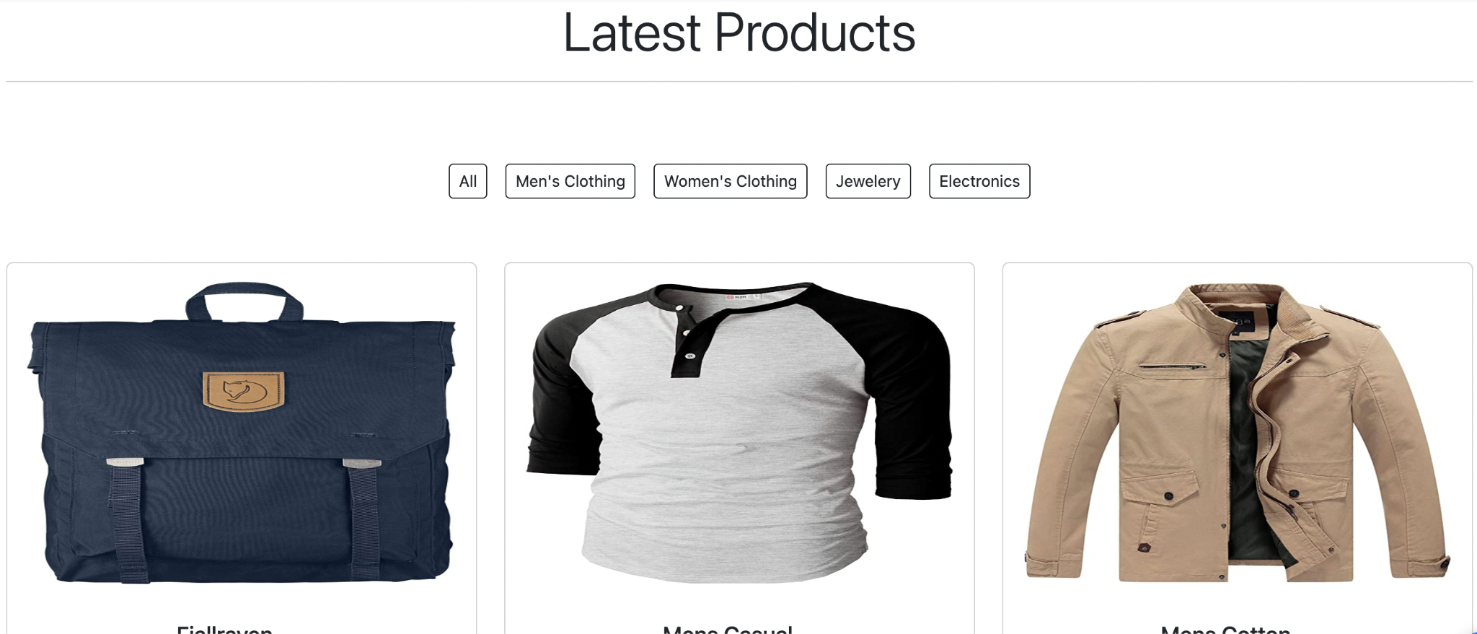
Product Catalog

Slide 11
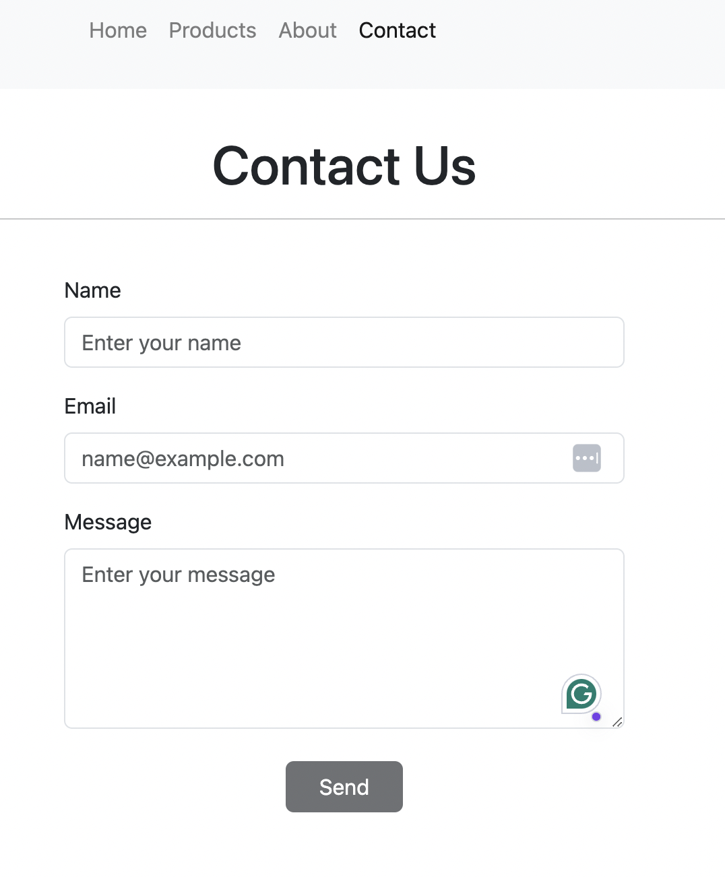
Contract us Layout
Customer Inquires
Sent the Message

Slide 12
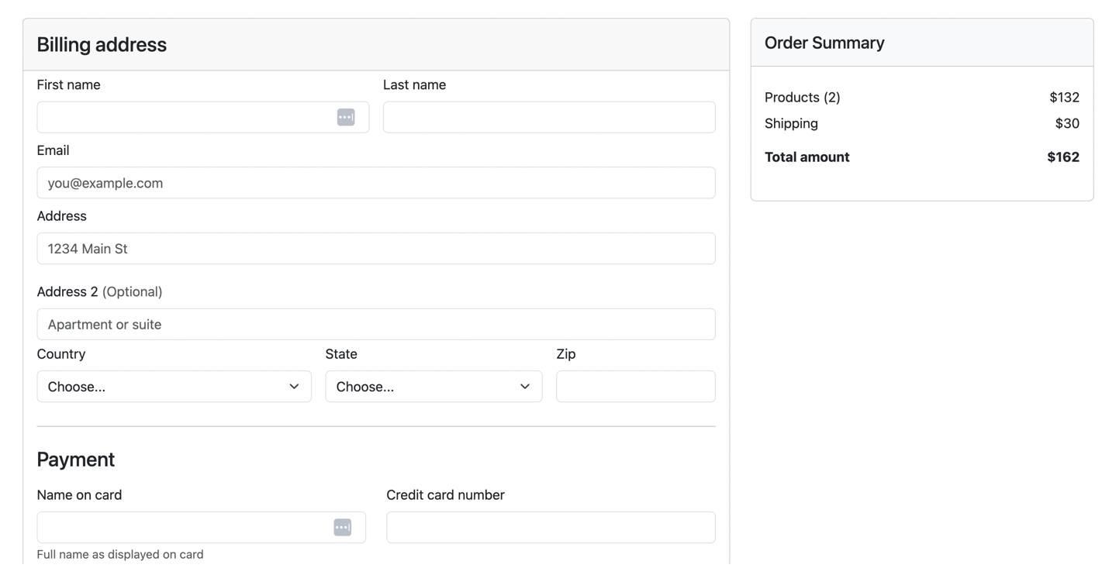
Checkout Process

Slide 13
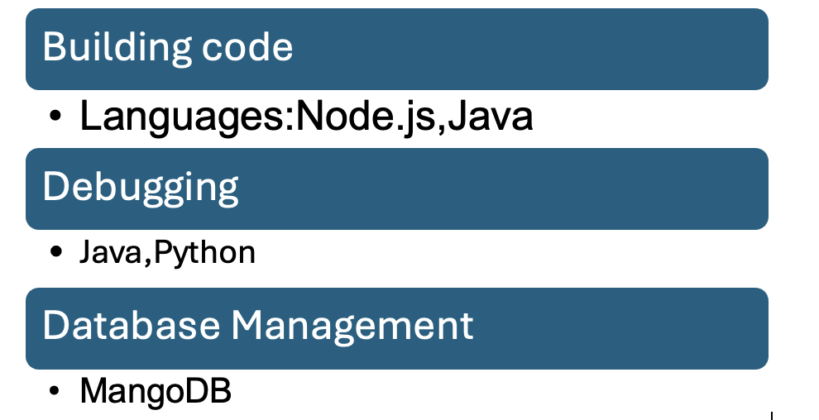
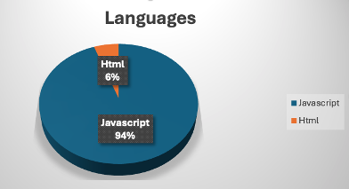
Back-end Figures

Slide 14
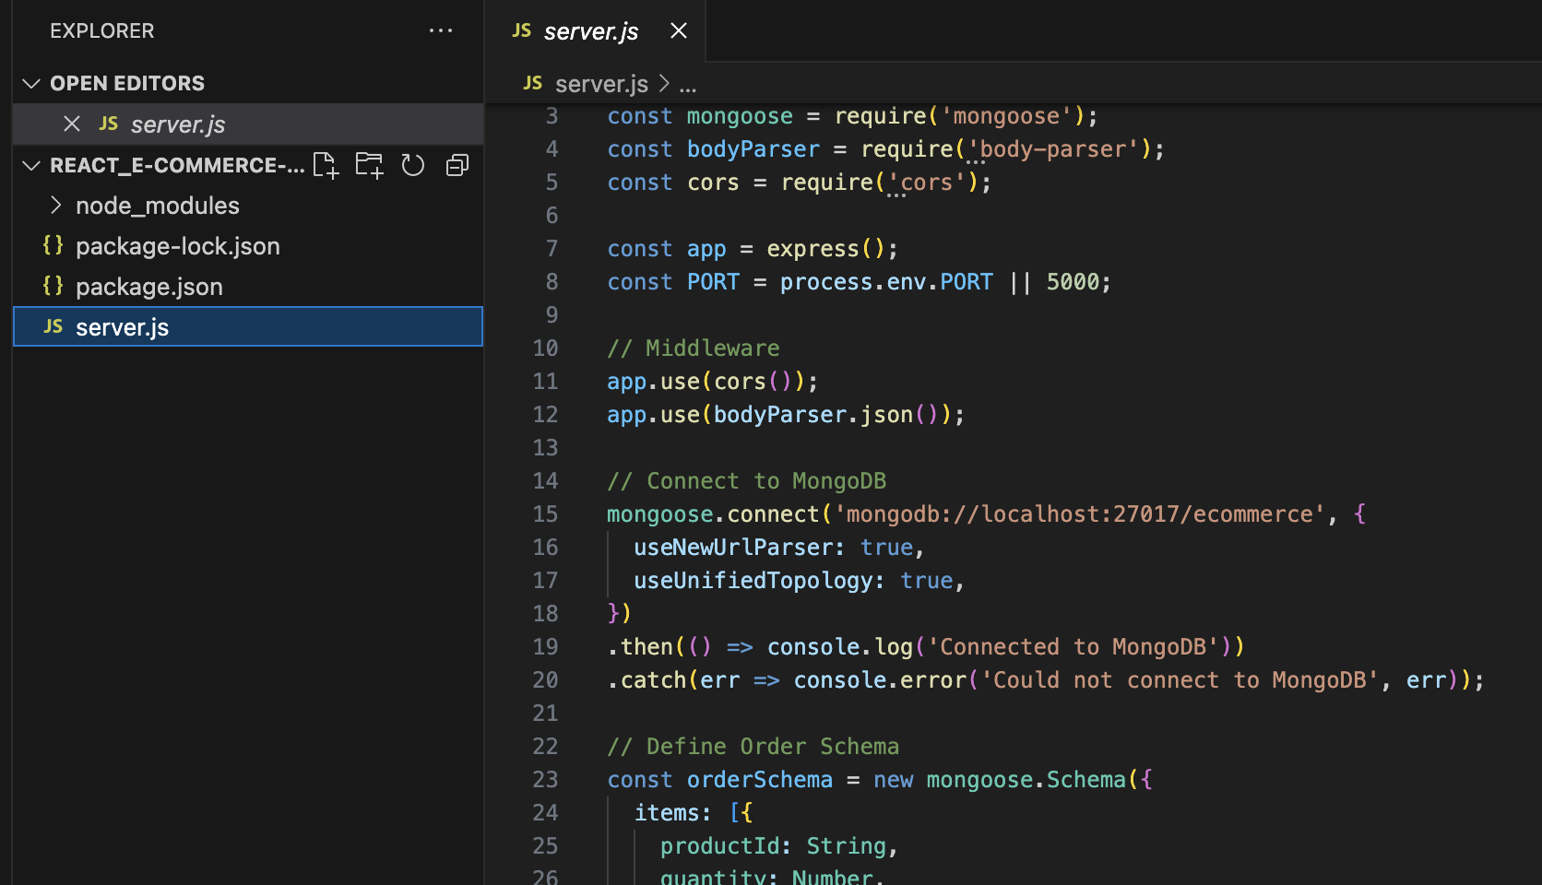
Backend Server Code

Slide 15
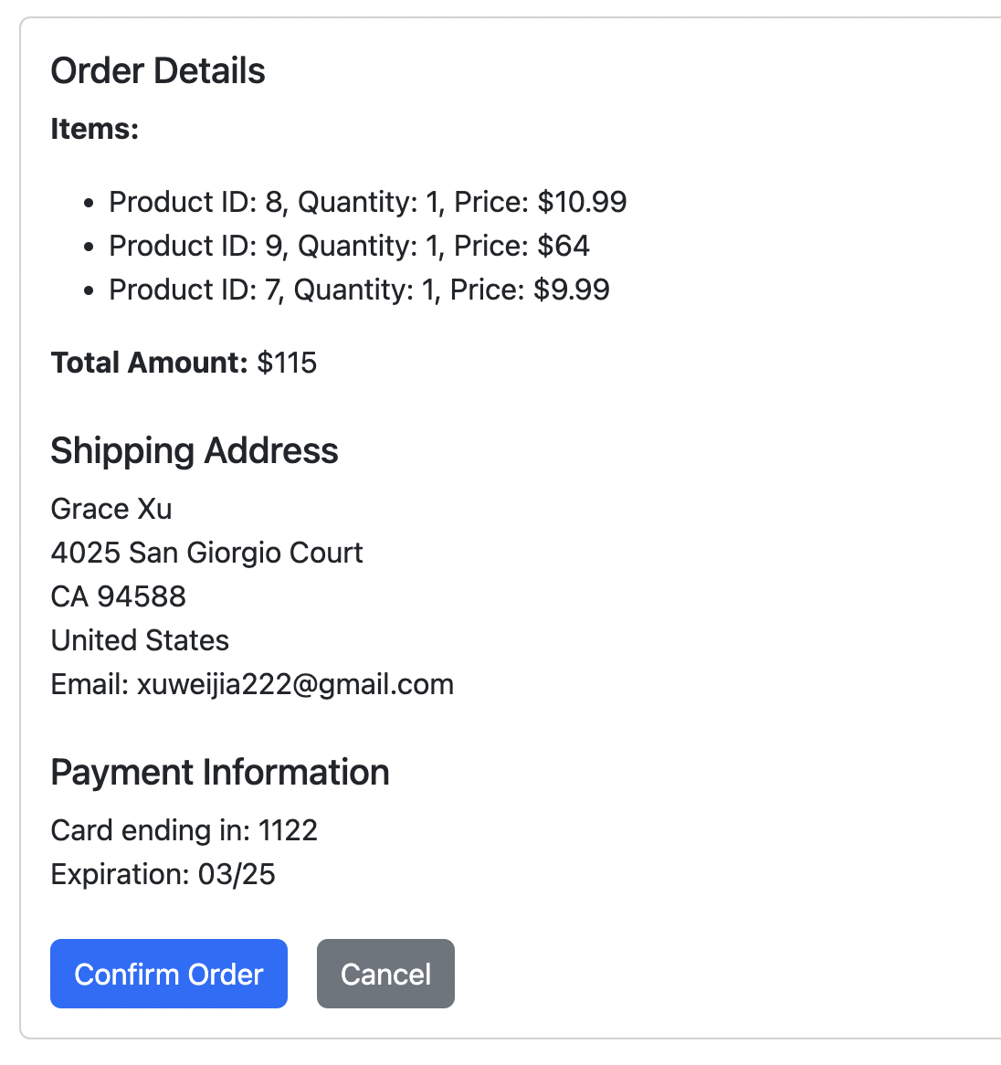
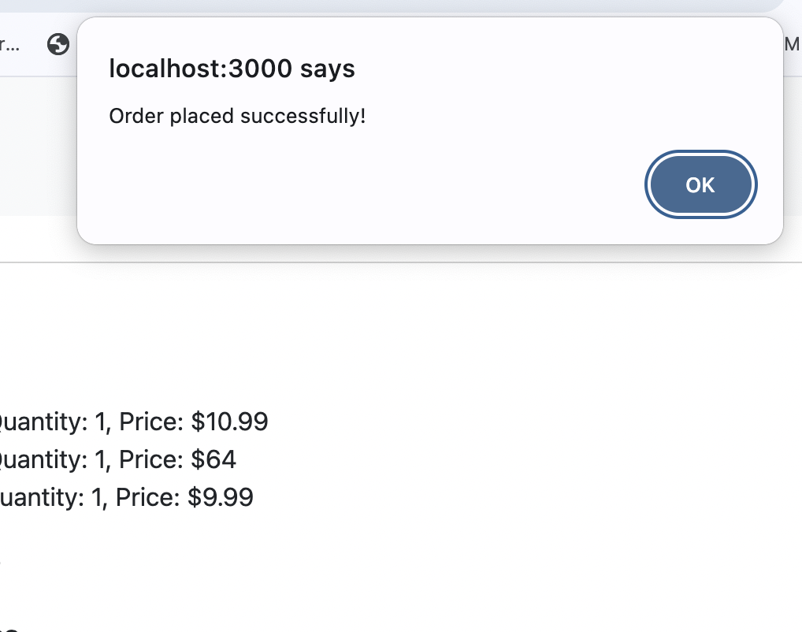
Backend API

Slide 16
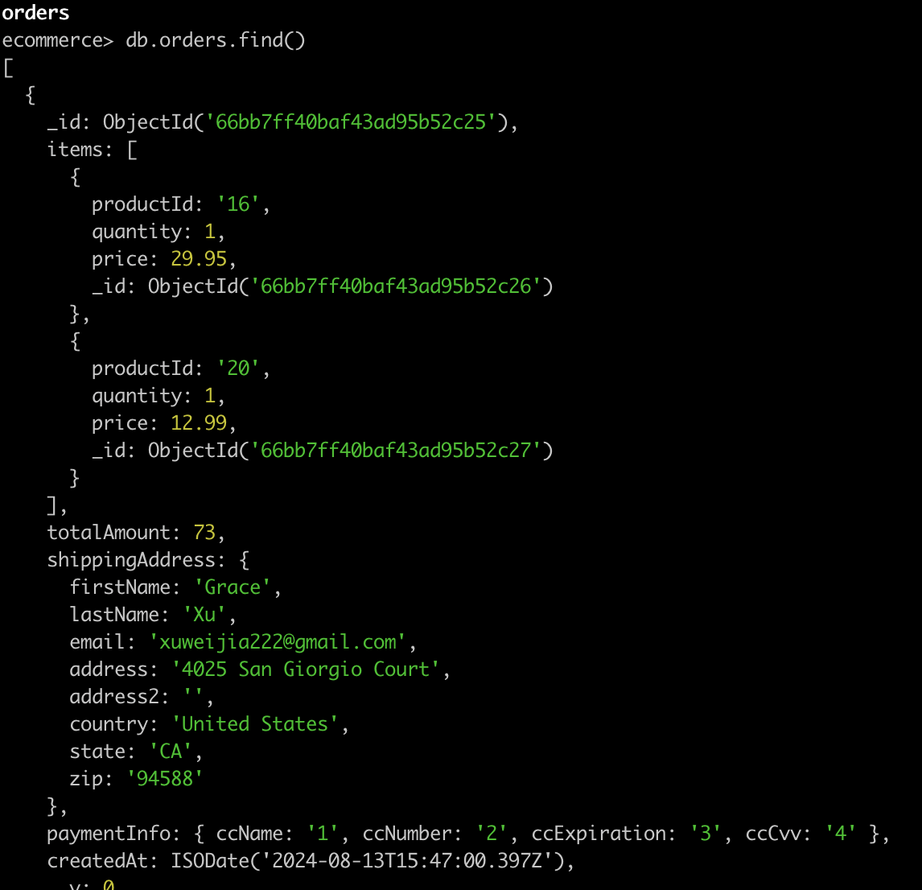
Backend Database Find
Database Schema follow the Design Logic
Adding Database Schema

Slide 17
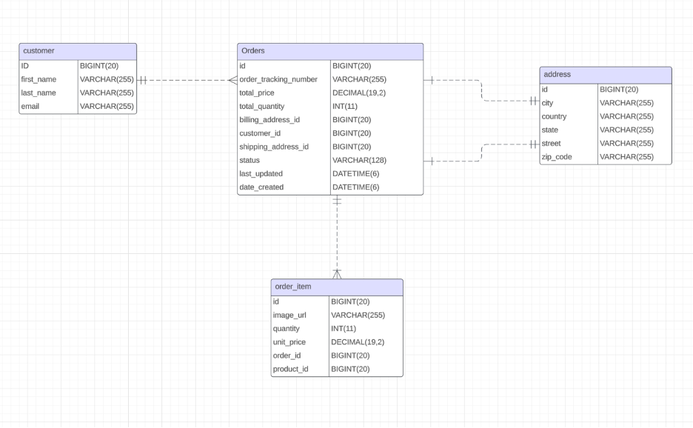
DataBase Schema

Slide 18
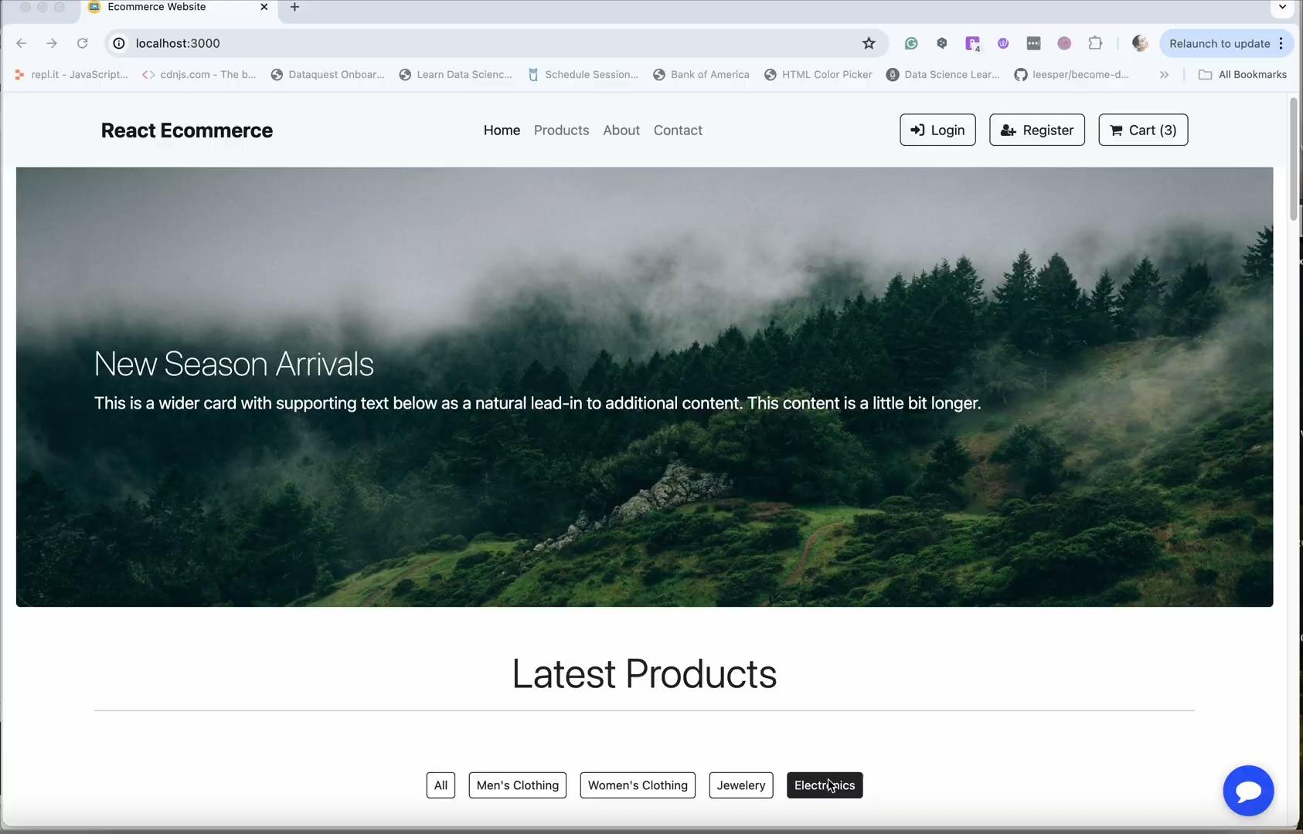
Project Demo

Slide 19
Backend Demo

Slide 20
Conclusion
In summary, the website design project has been a resounding success, achieving all its goals and exceeding expectations. We are confident that this website will serve as a valuable asset for this project, enhancing online presence and driving business growth, ensuring that it remains at the forefront of website design and technology.

Slide 21
Reference
1. Google Cloud. (n.d.). Introduction to OAuth 2.0. Retrieved from https://cloud.google.com/apigee/docs/api-platform/security/oauth/oauth-introduction
2. JSON Web Tokens. (n.d.). Introduction to JSON Web Tokens. Retrieved from https://jwt.io/introduction
3. Spring Quickstart Guide. Quickstart. (n.d.). https://spring.io/quickstart
4. Angular. Home • Angular. (n.d.). https://angular.dev/tutorials/learn-angular
5. Johnson, L., & Wang, M. (2022). Best Practices in Web Design: A Guide for Modern Websites. Retrieved from https://agupubs.onlinelibrary.wiley.com/doi/full/10.1029/2022GL098233
6. Davis, A. (2021). Web Design Principles for User Experience. Retrieved from https://www.researchgate.net/publication/361717406_Impact_of_website_visual_design_on_user_experience_and_website_evaluation_the_sequential_mediating_roles_of_usability_and_pleasure
7. Thompson, R. (2020). Emerging Trends in Web Design: A Comprehensive Review. Retrieved from Thompson, R. (2020). Emerging Trends in Web Design
8. (n.d.). Web Design: The Complete Reference. Retrieved from https://webdesignref.com/

Slide 22
Q&A
Thank you for listening!

